Slide 1
Analysis of US and English-speaking Markets

Slide 2
Overview and problem statement
The United States has traditionally been our strongest market
Before exporting its product lines & strategies overseas, is there a real difference in sales?
By how much on average?
Notes:
We are framing this problem in terms of a clear business need. And asking the question, what is this analysis actually going to do for our business, right? Remember, it’s our world, the statistics are just living in it!

Slide 3
Data analyzed
Approximately 2,800 orders from Jan 2003 - May 2005
Data includes order amount, product type, and customer information
Raw data available here
Notes:
Set the stage a bit -- where is the data coming from? Be as transparent as possible. Explain to the audience what you were thinking about data collection in terms of what data was necessary and how that in turn shaped your thinking on the kind of analysis that would be most appropriate given the objective.

Slide 4
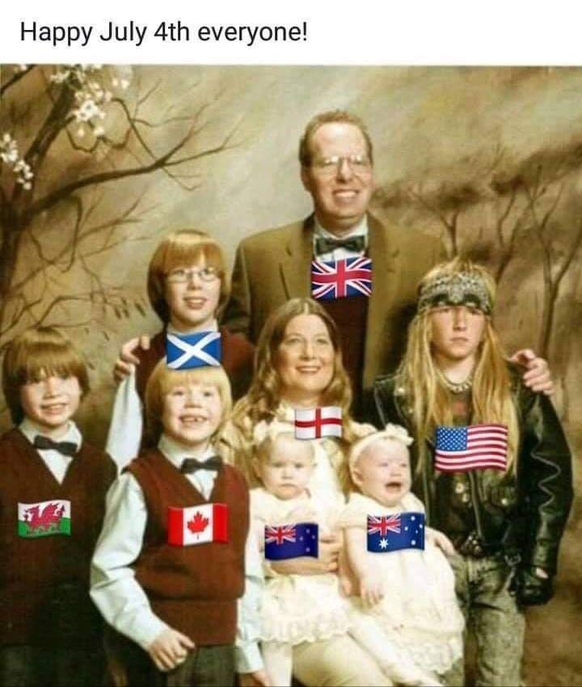
Cultural fit: Focus on other English-speaking countries
Notes:
Moving from research question to some kind of hypothesis -- you want to use logic, theory and prior empirical evidence to move toward some hypotheses you can test. This is why domain expertise cannot be overlooked among data scientists.

Slide 5
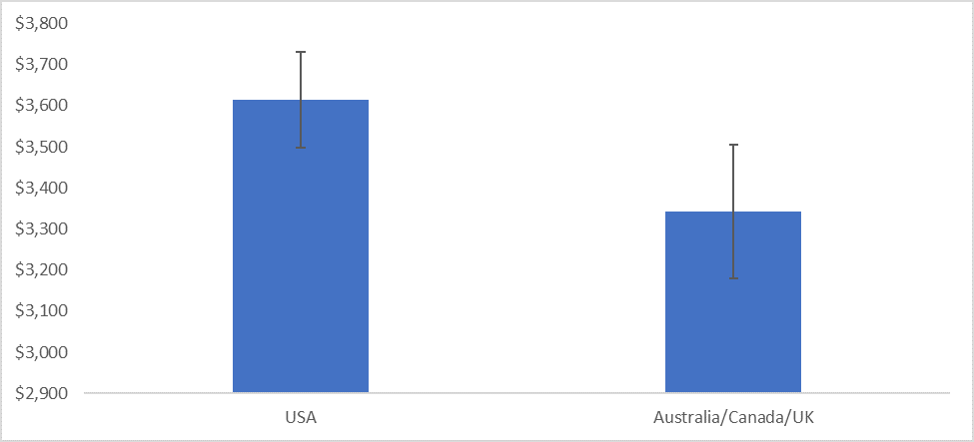
Statistically significant difference between US and Australia/Canada/UK Sales:
With 95% confidence, the average sale is between $71 and $471 higher in the US
For the 399 sales in our sample, this translates to a possible lift of between $28K and $187K
Notes:
A statistical method is not a story, but we can tell a story from the statistics. For example, using confidence intervals we can put into dollars what we think would happen if we make some business move, given the data that we have.
The words “t-test,” “normality,” “independent samples” etc did not come up at all in this explanation! Although someone who does know about this stuff can still have confidence in the results with the way you have laid out the story and the quantifiable results.

Slide 6

With such a swing, start small
Identify US-only products that may work well overseas
A/B test small differences on subsets of stores
Notes:
https://unsplash.com/photos/OX_en7CXMj4
Then we want to move to recommendations, what is the call to action? What should your audience do now that they know what you have told them?

Slide 7
Questions?

Slide 8
Thank You

